Slide 1

PART-A Predicting AI Tool Usage Patterns Using
Classification Models Department of Computer Science and Engineering Seshadri Rao Gudlavalleru Engineering College, Gudlavalleru.
Under the Guidance of Dr. G.V. S.N.V.R Prasad, M.S., M.Tech, Ph.D., Professor of CSE & Director(PGCRD)
Presented By,
M. JNANA PRASANNA (22481A05E0) P. SANJANA (22481A05J1) M. SHRIVALLI (22481A05F8) M. RAJ VARDHAN (22481A05E7)

Slide 2
ABSTRACT
The aim of this project is to predict AI tool usage patterns using classification models. By leveraging machine learning techniques, this study analyzes user behavior and adoption trends of AI tools across various domains. The objective is to identify key factors influencing AI tool usage and determine the most effective classification model for accurate predictions. This research helps organizations and developers understand user preferences and make data-driven decisions for AI tool development.

Slide 3
REQUIREMENTS
Hardware Requirements:
Processor: Intel i7 or higher (recommended: i5/i7 for faster performance)
RAM: Minimum 4 GB (recommended: 8 GB or higher for handling larger datasets)
Hard Disk: At least 1 GB of free space for Orange and dataset storage
Display:Minimum 1024x768 resolution
Operating System: Windows 10 or higher / macOS / Linux (64-bit)
Software Requirements:
Orange Data Mining Tool:isual data analysis and modeling (version 3.x recommended)
Microsoft SSMS:Managing and querying relational databases (SQL Server)
MicrosoftVisualStudio:Development and integration environment for coding
Microsoft Excel / CSV Tool:For dataset formatting and conversion

Slide 4
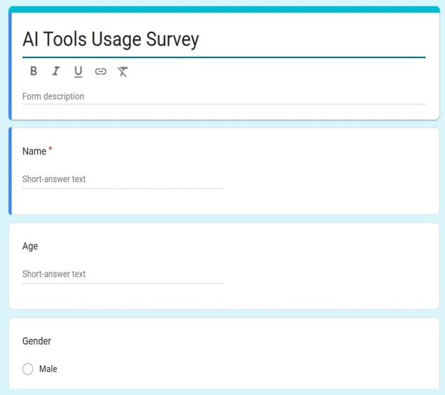
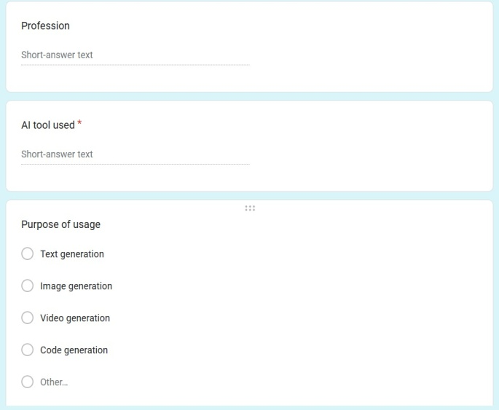
Google Form of Our Survey

Slide 5
PROBLEM STATEMENT
Predicting AI tool usage patterns by analyzing user demographics, behavior, and preferences using classification models. It focuses on identifying key factors that influence the frequency and likelihood of AI tool adoption.
This project aims to analyze and predict user behavior related to AI tool usage using classification models. It seeks to identify key factors influencing AI adoption across different user demographics. The goal is to build a predictive model that categorizes users based on their likelihood of using AI tools.

Slide 6
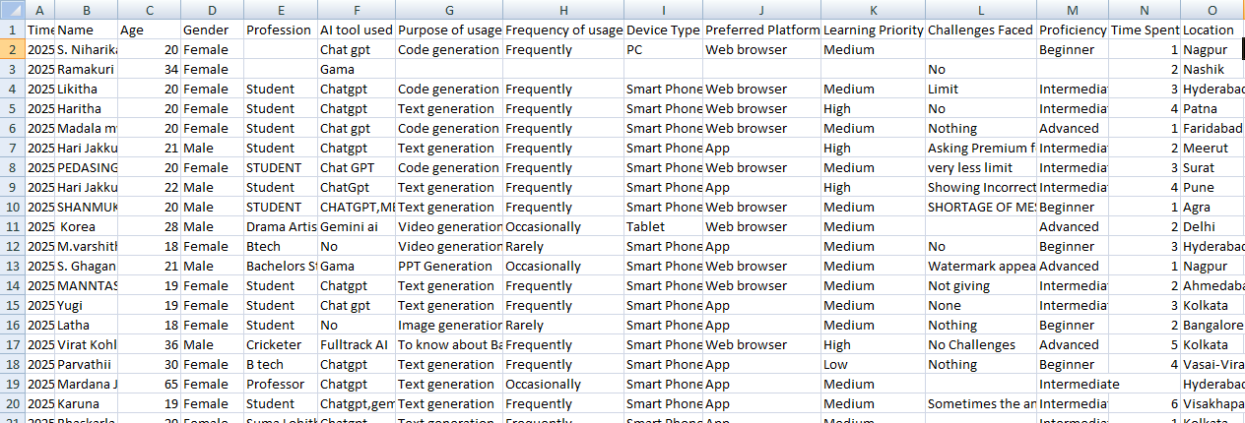
Dataset
Dataset is collected Using Google Forms

Slide 7
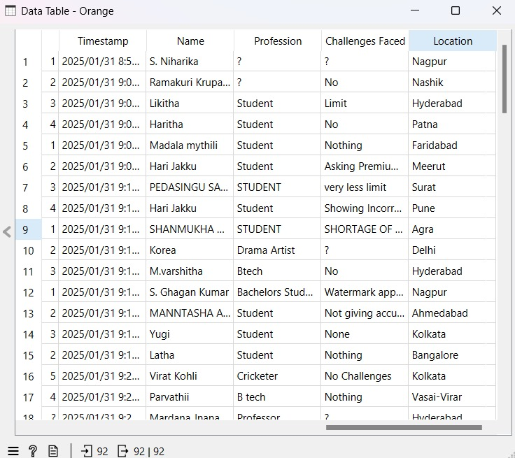
Preprocessing of dataset
Preprocess the Dataset Using Orange Tool,My dataset has missing values
Before imputing

Slide 8
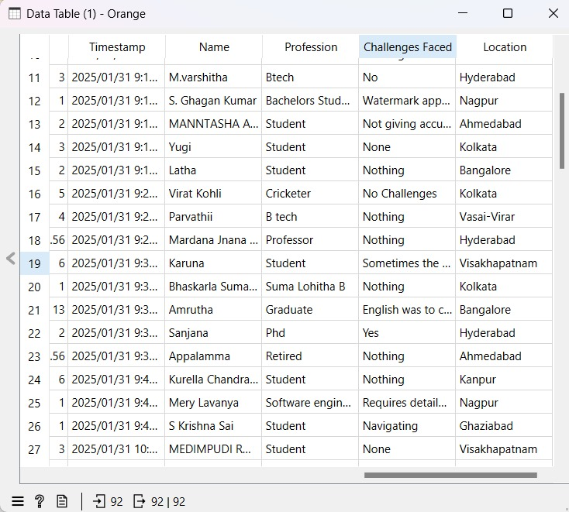
AFTER IMPUTING

Slide 9
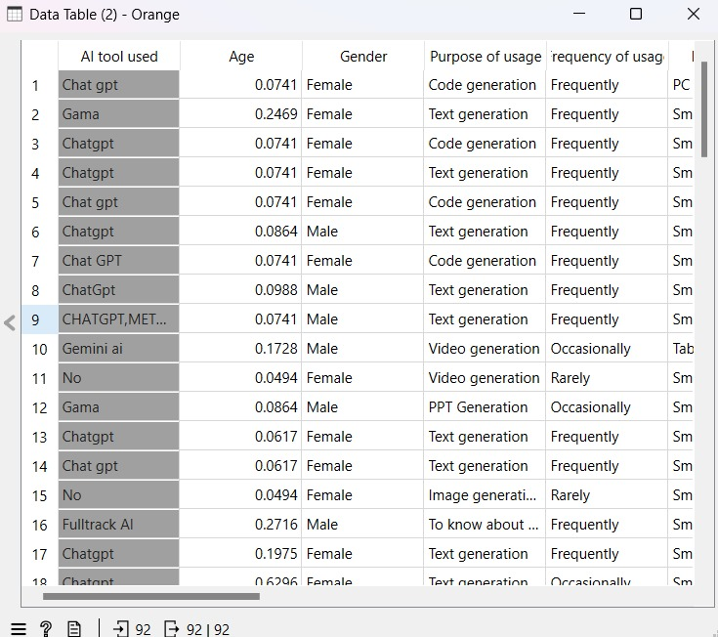
Normalized the numerical values using Normalization[0,1]
After normalization

Slide 10
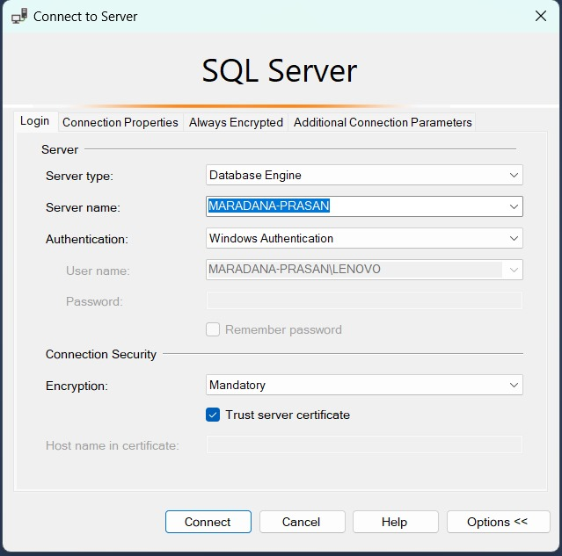
Generating SQL Queries for OLAP Schema Construction
Generate SQL Queries for OLAP Schema Construction
Designed Star Schema, Snowflake Schema, and Fact Constellation Schema.
I have created server type as database engine to create tables in database

Slide 11
Star schema
I have created 3 dimension tables and 1 fact table
The three dimension tables with attributes and fact table with attributes are below
Dimension tables :
1) Dim_AI_Tool
2) Dim_User
3) Dim_Usage
Fact table :
1) Fact_AI_Usage

Slide 12
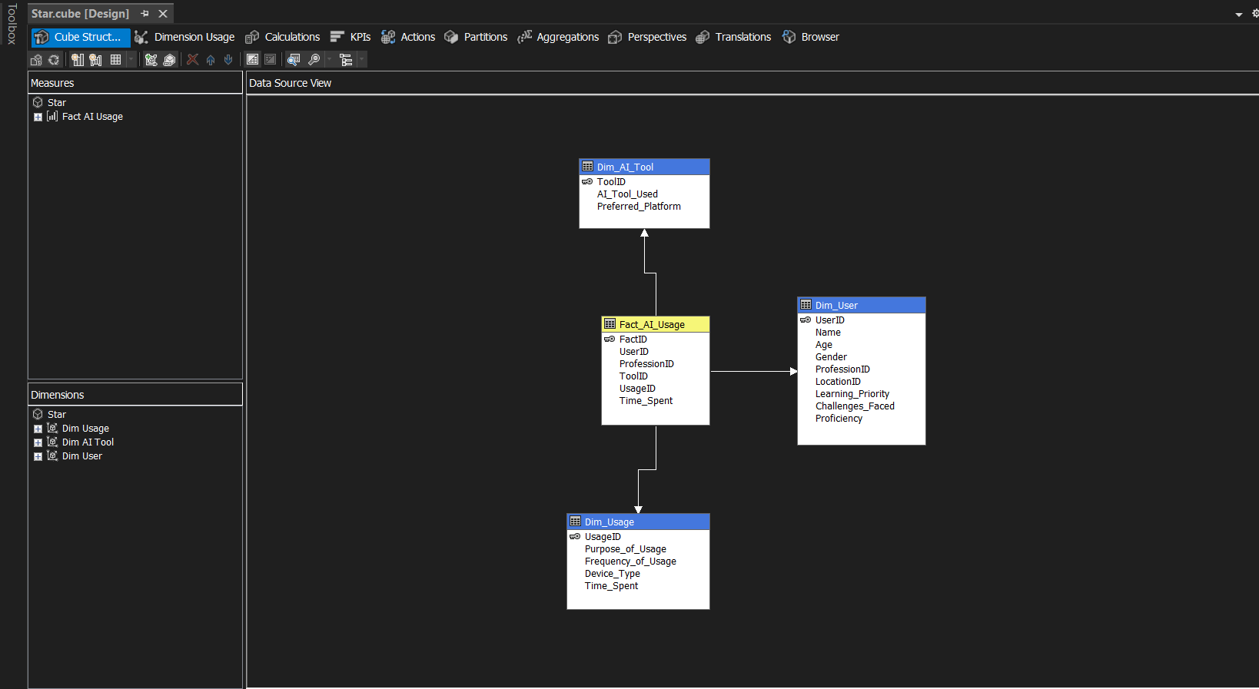
STAR SCHEMA

Slide 13
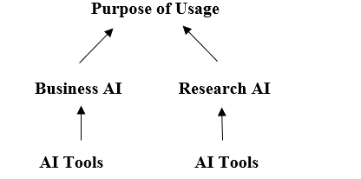
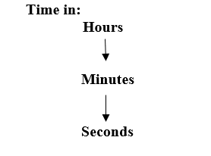
Concept Hierarchies used in star schema
Roll up
Drill Down

Slide 14
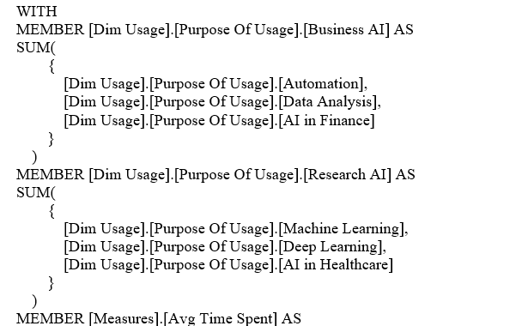
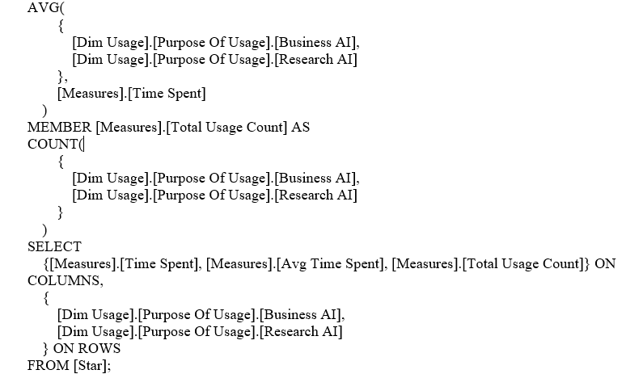
STAR SCHEMA-OLAP OPERATIONS
Roll-up:
Aggregate AI Usage purposes into 'Business AI' and 'Research AI' categories and compute the total Time Spent, average Time Spent, and total usage count for each.

Slide 15
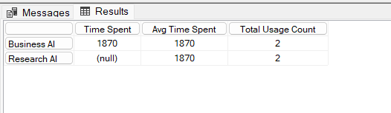
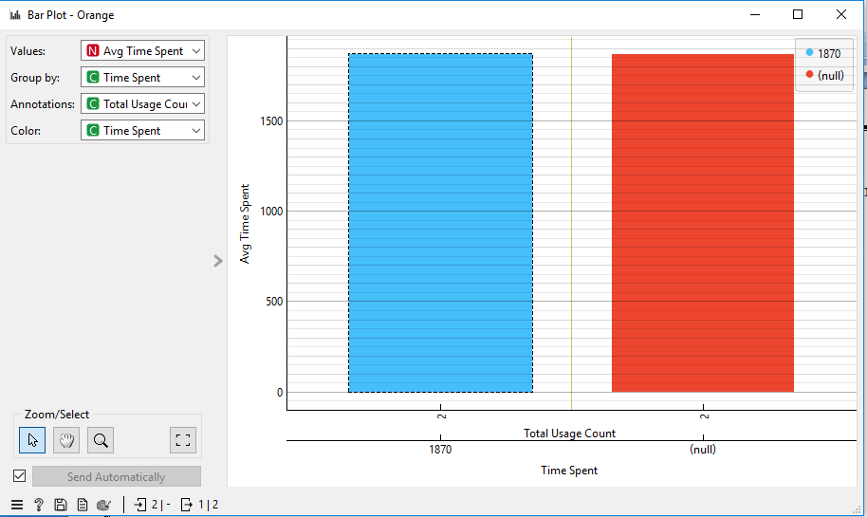
Output: Visualization:
Execution Time: 1 ms

Slide 16
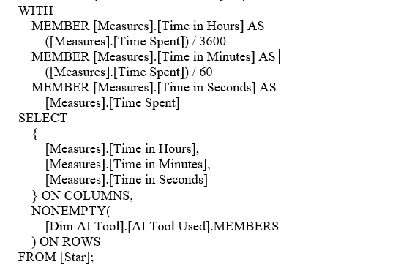
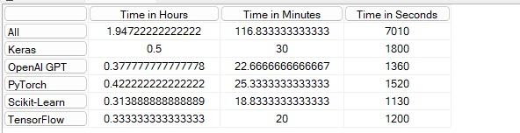
Drill-Down
(B) Time is spent using each AI tool, broken down in hours, minutes, and seconds.
Output:
Execution Time: 1 ms

Slide 17
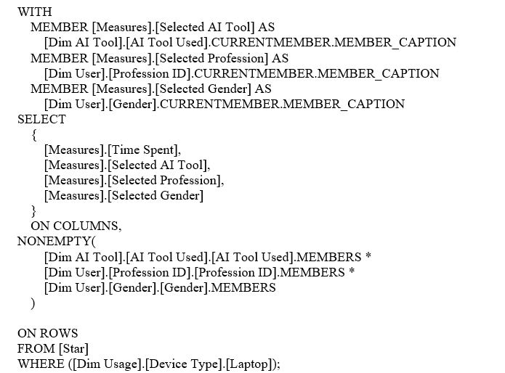
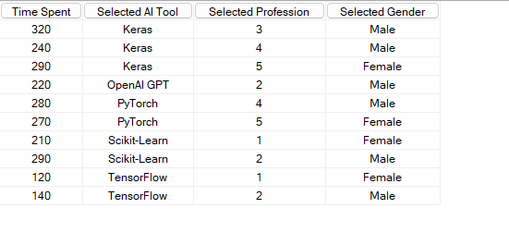
Slice: Analyze the usage of AI tools by filtering only for users who use Laptops as their Device Type.
Display the total Time Spent, categorized by AI Tool Used, User Profession, and Gender."
Output:
Execution Time: 1 ms

Slide 18
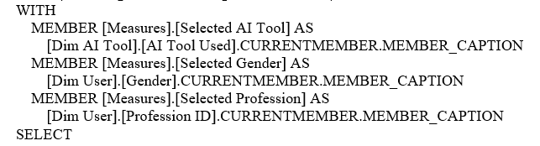
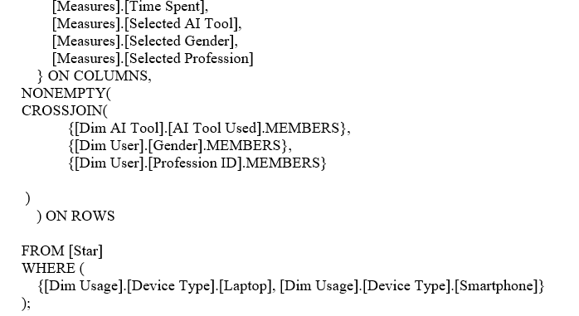
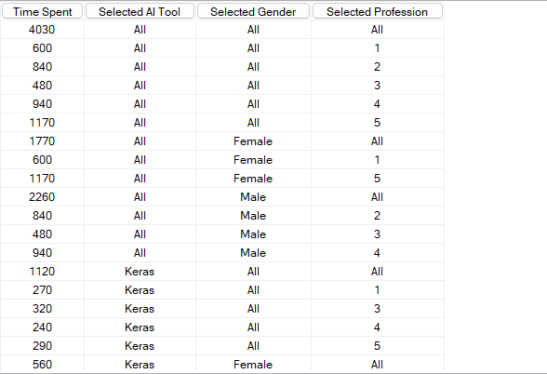
Dice: Analyze the AI tool usage by different users. Show the total Time Spent on AI tools, categorized by AI Tool Used, User Gender, Profession, and Device Type (Laptop and Smartphone)."
Output:
Execution Time: 1 ms

Slide 19
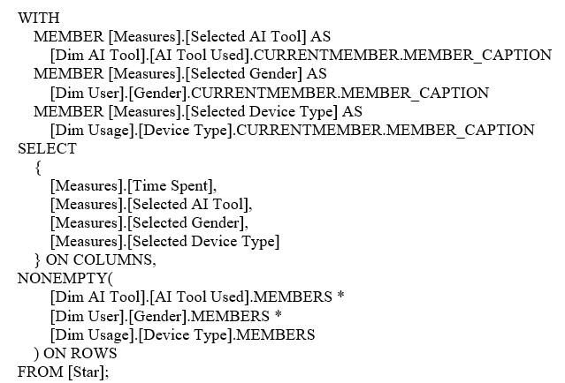
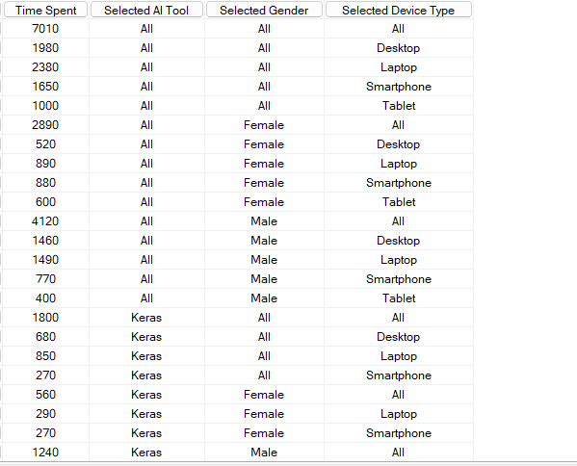
Pivot:
(E) Provide a breakdown of AI tool usage, displaying the total Time Spent along with AI Tool Used,
User Gender, and Device Type. Ensure that the columns are properly labeled for clarity
Output:
Execution Time: 1 ms

Slide 20
Snow flake schema
I have created 3 dimension tables and 2 extended tables and 1 fact table
The three dimension tables with attributes and fact table with attributes are below
Dimension tables :
1) Dim_User
2) Dim_Usage
3) Dim_AI_Tool
Extended tables :
1) Dim_Profession
2) Dim_Location
Fact table :
1) Fact_AI_Usage

Slide 21
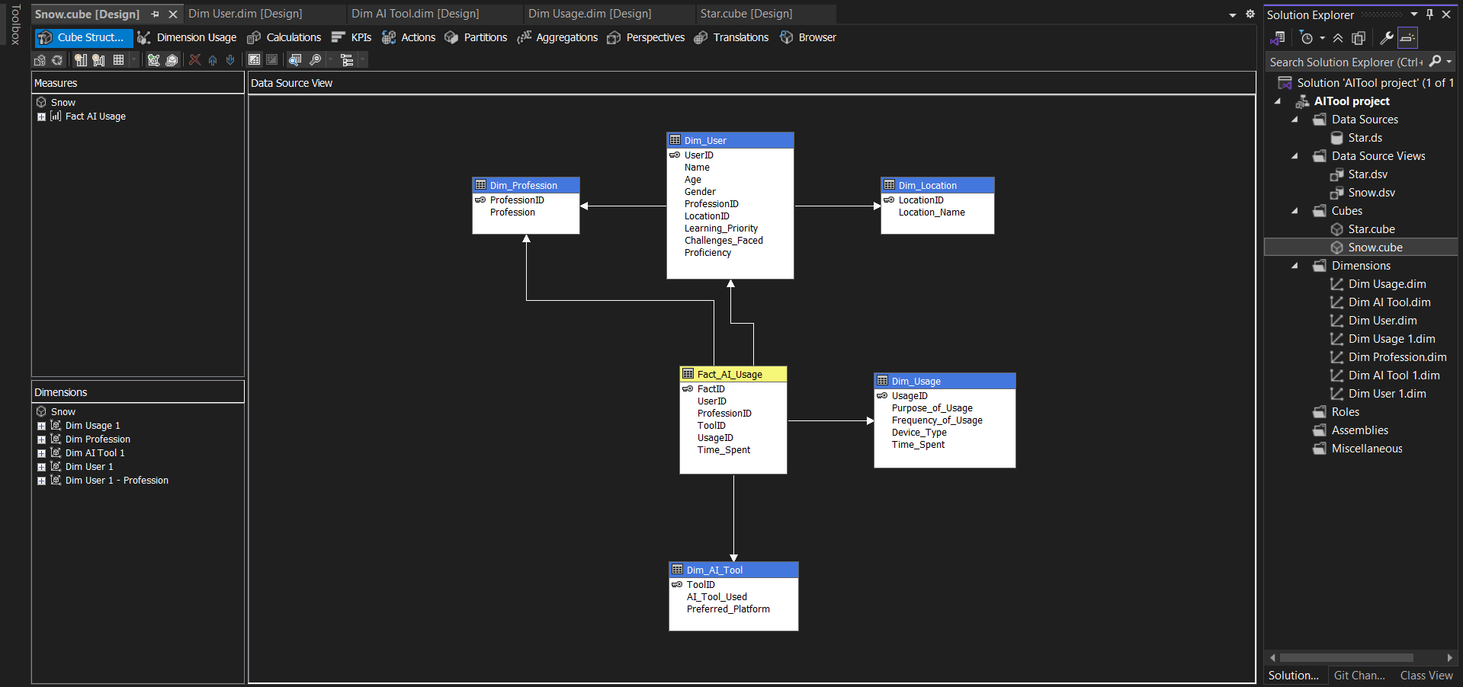
Snow flake schema

Slide 22
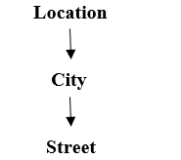
Concept Hierarchy used in snow flake schema
Roll up Drill down

Slide 23
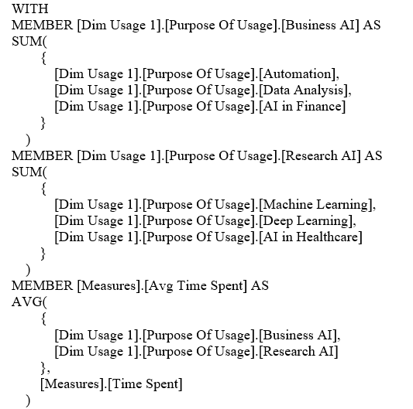
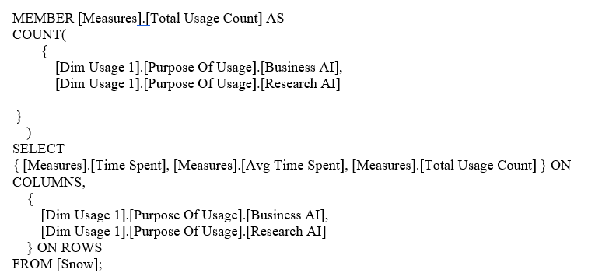
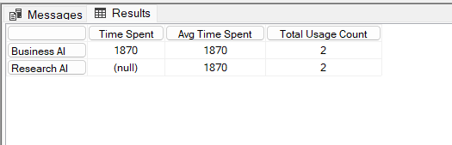
SNOW FLAKE SCHEMA-OLAP OPERATIONS
Roll-up:
(A) Summarize AI tool usage by categorizing Purpose of Usage into Business AI and Research AI. Show the total and average Time Spent for each category."
Output:
Execution Time: 1 ms

Slide 24
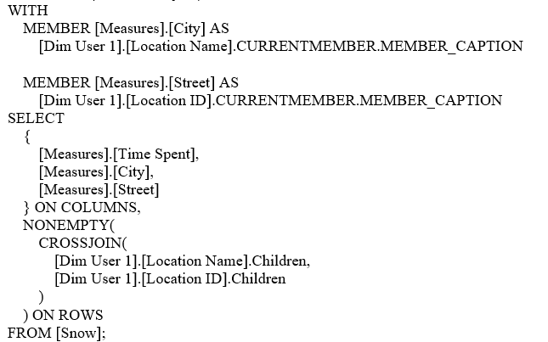
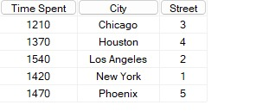
Drill Down
Analysis of Time Spent by City and Street Location
Output:
Execution Time: 1 ms

Slide 25
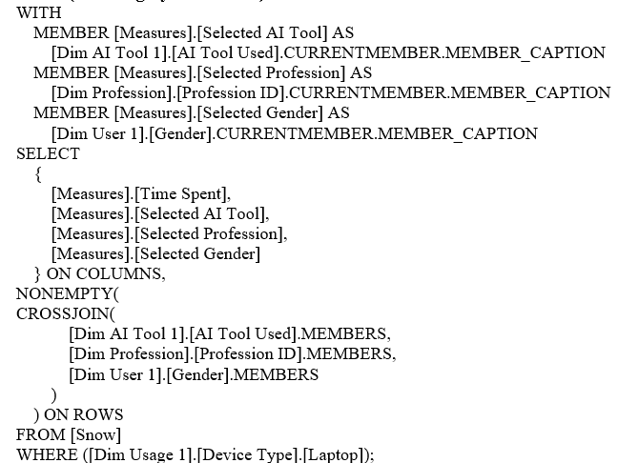
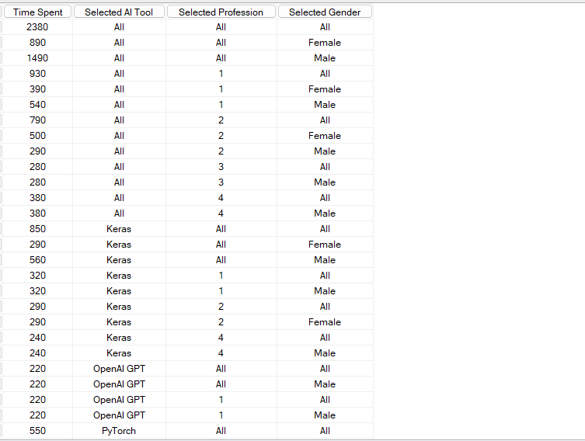
Slice:
"Retrieve Time Spent on AI tools for users using Laptops, categorized by AI Tool Used, Profession, and Gender.
Output:
Execution Time: 1 ms

Slide 26
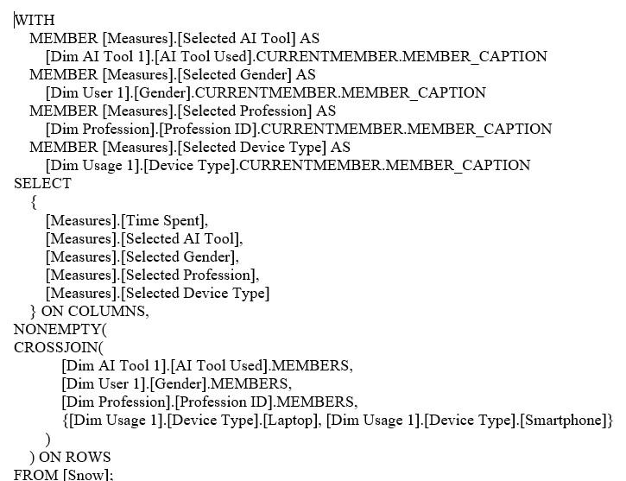
Dice:
Analyze Time Spent on AI tools for users by AI Tool Used, Gender, Profession, and selected Device
Types (Laptop and Smartphone)

Slide 27
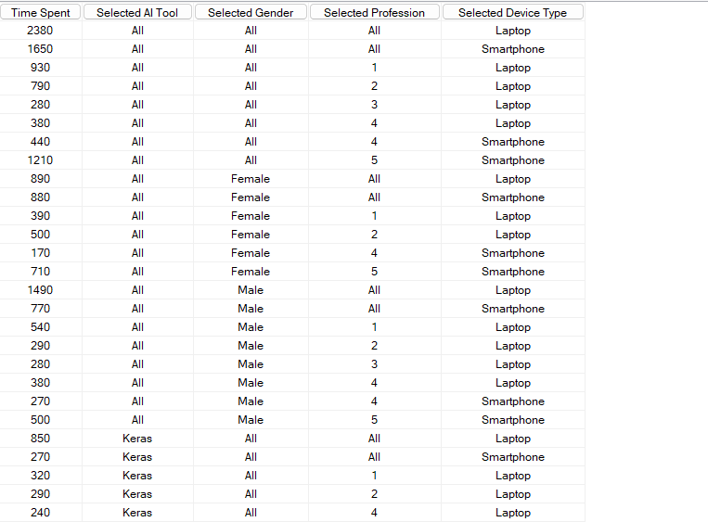
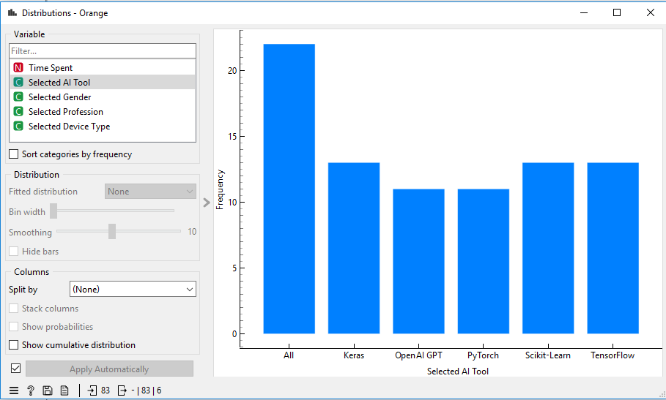
Output: Visualization:
Execution Time: 1 ms

Slide 28
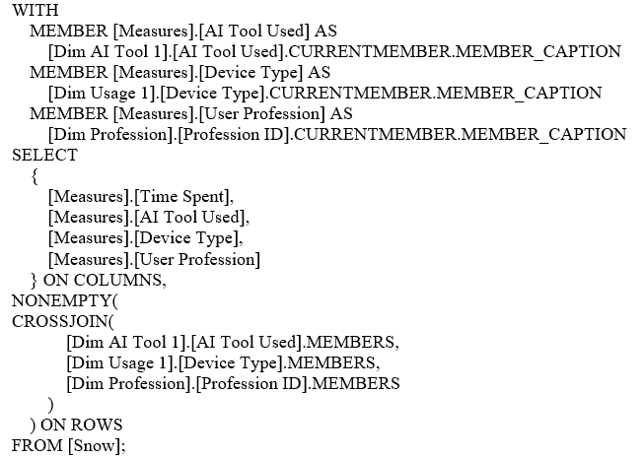
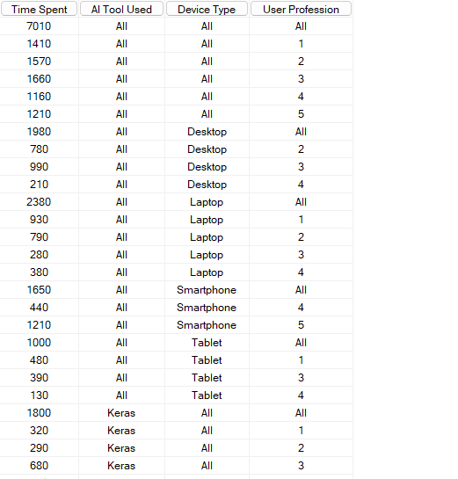
Pivot:
(E) Pivot AI Tool Used against Device Type and User Profession to analyze Time Spent.
Output:
Execution Time: 1 ms

Slide 29
FACT CONSTELLATION SCHEMA
I have created 3 dimension tables and 2 extended tables and 2 fact tables
The three dimension tables with attributes and fact table with attributes are below
Dimension tables :
1) Dim_User
2) Dim_Usage
3) Dim_AI_Tool
Extended tables :
1) Dim-Location
2) Dim_Profession
Fact table :
1) Fact_AI_Usage
2) Fact_Skill_Analsys

Slide 30
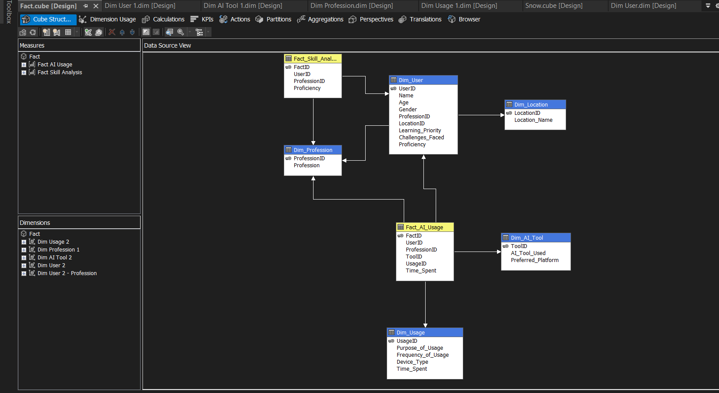
FACT CONSTELLATION SCHEMA

Slide 31
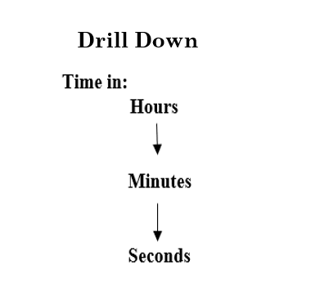
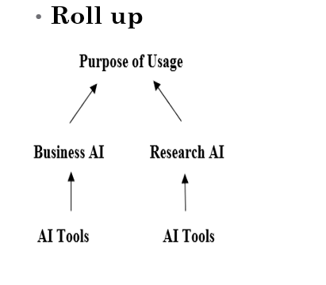
Concept Hierarchy used in Fact Constellation

Slide 32
FACT CONSTELLATION-OLAP OPERATIONS
Roll-up:
(A) Summarize AI tool usage by categorizing Purpose of Usage into Business AI and Research AI. Show the total and average Time Spent for each category."
Output:
Execution Time: 1 ms

Slide 33
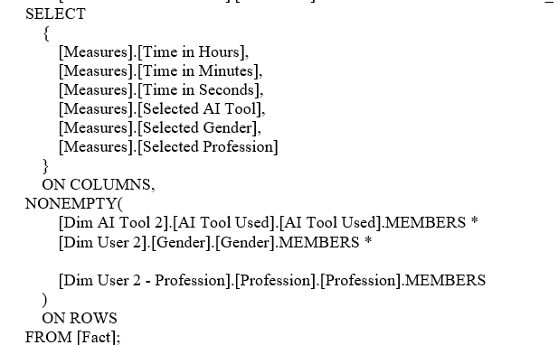
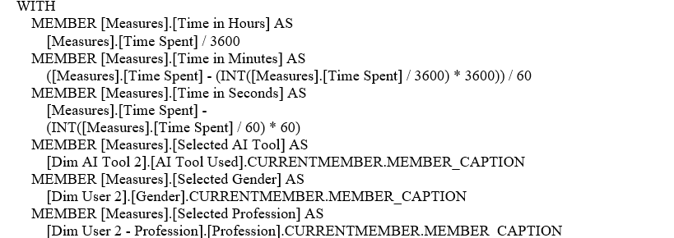
Drill Down:
Total time spent (in hours, minutes, and seconds) on different AI tools distributed across gender and
Profession

Slide 34
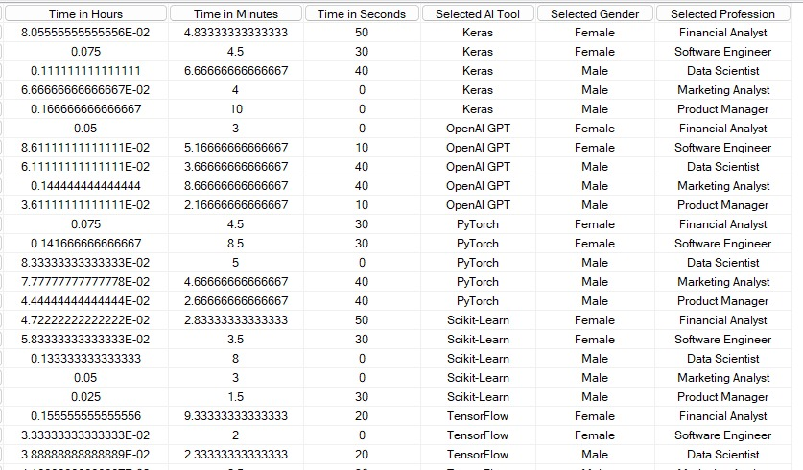
Output:
Execution Time: 1 ms

Slide 35
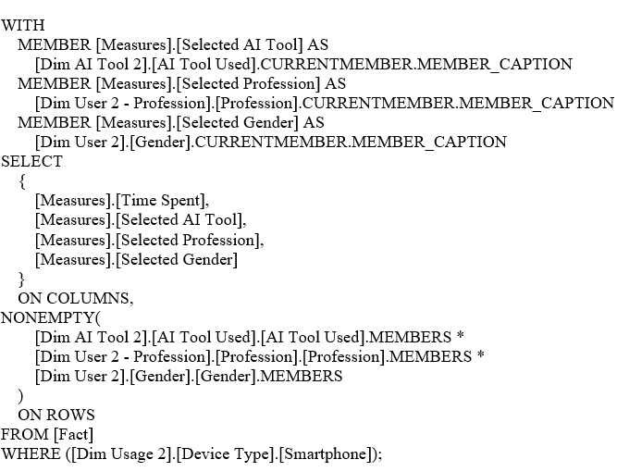
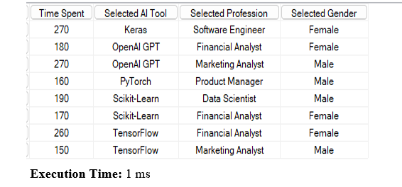
Slice
Slice the data to display Time Spent, along with selected AI Tool Used, Profession, and Gender, only
for users who accessed AI tools using a Smartphone.
Output:

Slide 36
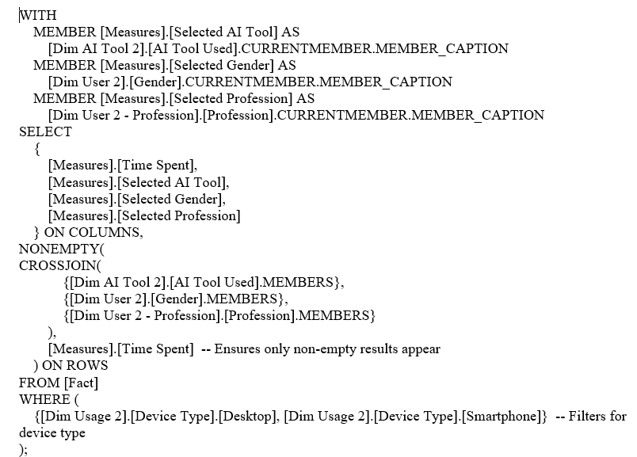
Dice:
(D) Filter the dataset to display Time Spent, AI Tool Used, Gender, and Profession for users who accessed AI tools using either Desktop or Smartphone, and whose Proficiency Level is Advanced.

Slide 37
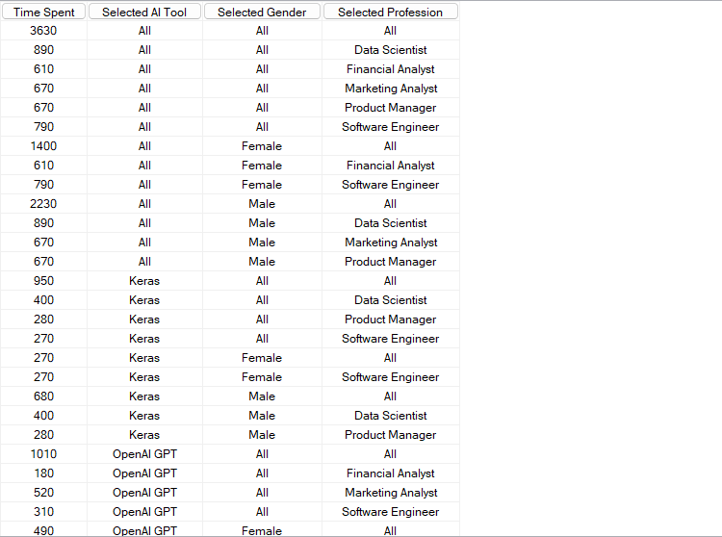
Output:
Execution Time: 1 ms

Slide 38
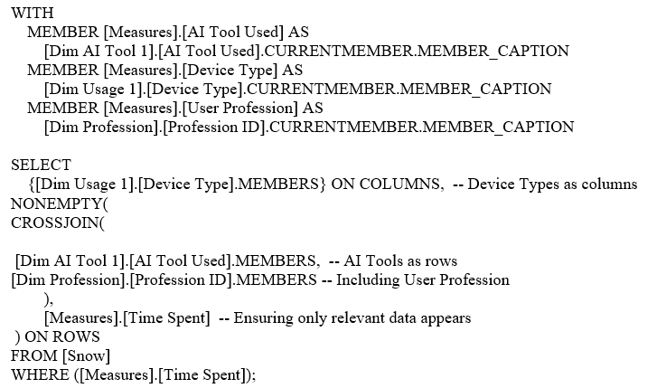
Pivot:
(E) Pivot the AI Tool Used against Device Type and User Profession to analyze the Time Spent, with a
breakdown showing totals per tool and professionQuery:

Slide 39
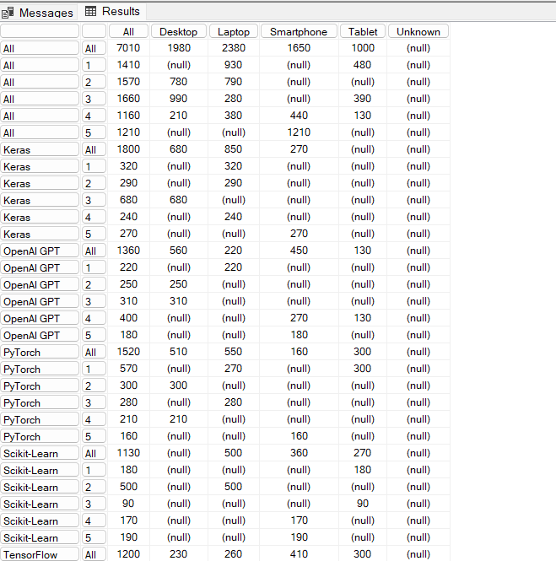
Output:
Execution Time: 1 ms

Slide 40
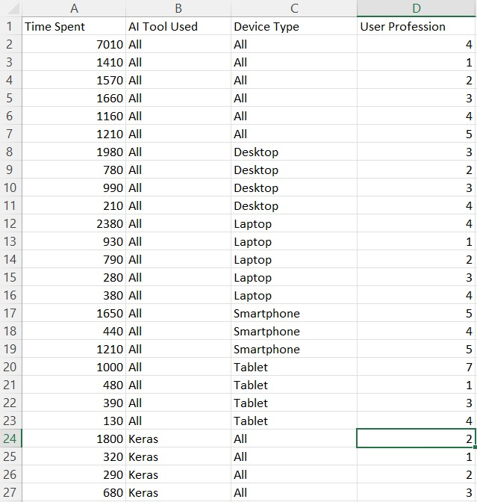
Perform Data Mining on the Dataset

Slide 41


We applied normalization as preprocessing technique
To check which model is best,we use test score to decide
Without preprocessing With preprocessing
Best Model: Random Forest

Slide 42


EVALUATION METRICS:
Confusion Matrix
Without preprocessing With preprocessing

Slide 43

ENTIRE WORKFLOW

Slide 44

Distributions -Analysis

Slide 45


Slide 46
Glass Identification and Classification Based on Elemental Properties
PART-B

Slide 47
PROBLEM STATEMENT
The objective of this project is to develop a predictive model that accurately classifies glass samples
into their respective types based on their elemental composition. Given the concentrations of various
chemical elements such as sodium (Na), magnesium (Mg), aluminum (Al), silicon (Si), potassium
(K), calcium (Ca), barium (Ba), and iron (Fe), the model should predict the type of glass (e.g.,
building windows, vehicle windows, containers, etc.).
We will evaluate multiple supervised learning algorithms to determine the most effective model for
Glass classification, ensuring high accuracy and reliability in structural analysis. Through data
preprocessing, feature selection, and model evaluation using performance metrics such as accuracy,
precision, recall, and F1-score, this study aims to provide insights into Glass Classification.

Slide 48

Dataset
This dataset includes glass samples described by nine features: the refractive index and concentrations of eight elements (Na, Mg, Al, Si, etc.). The target variable is the glass type, classified into seven categories like building windows, vehicle windows, and containers.

Slide 49
Preprocessing of Dataset
We have preprocessing technique: Normalize features scale to σ² = 1

Slide 50

After preprocessing

Slide 51


After all the observations , we choose to evaluate Random Forest and Navie Bayes algorithms
Before preprocessing After preprocessing
.
KNN: 0.046(Decreased)
Logistic Regression: 0.028(Increased)
Random Forest: 0.019 (Increased)
Models like Tree, Neural Network, SVM, and Naive Bayes maintained stable CA values.

Slide 52

ENTIRE WORKFLOW

Slide 53

Bar plot-Analysis

Slide 54


Slide 55
FINAL ANALYSIS
PART-C

Slide 56
Experimental Analysis
PART-A(CALSSIFICATION)
KNN,
SVM,
Random Forest
. Comparsion done by classification accuracy (CA), and confusion matrices
PART-B(CALSSIFICATION)
KNN,
SVM,
Random Forest
comparision done by classification accuracy (CA), and confusion matrices

Slide 57
Key Findings From Model Comparisions
Random Forest cosistently perform the best accross both datasets(AI-Tool dataset & Glass dataset).
In Part-A, Random Forest have highest accuracy i.e.,0.784 under Normalized feature σ² = 1.
In Part-B, Random Forest have highest accuracy i.e.,0.832 under Normalization feature [0,1].
Logistic Regression has weakest performance after preprocessing with accuracy 0.371 in Part-A.
Logistic Regression has weakest performance after preprocessing with accuracy 0.640 in Part-B.

Slide 58
CONCLUSION
This study compared two distinct approaches to classification tasks:
Part A leveraged a custom-generated survey dataset to predict AI tool usage patterns, achieving high accuracy with minimal preprocessing due to the dataset's inherent structure.
Part B utilized a real-world glass classification dataset, requiring extensive preprocessing but providing valuable insights into model performance under more challenging conditions.

Slide 59


